Slide 1
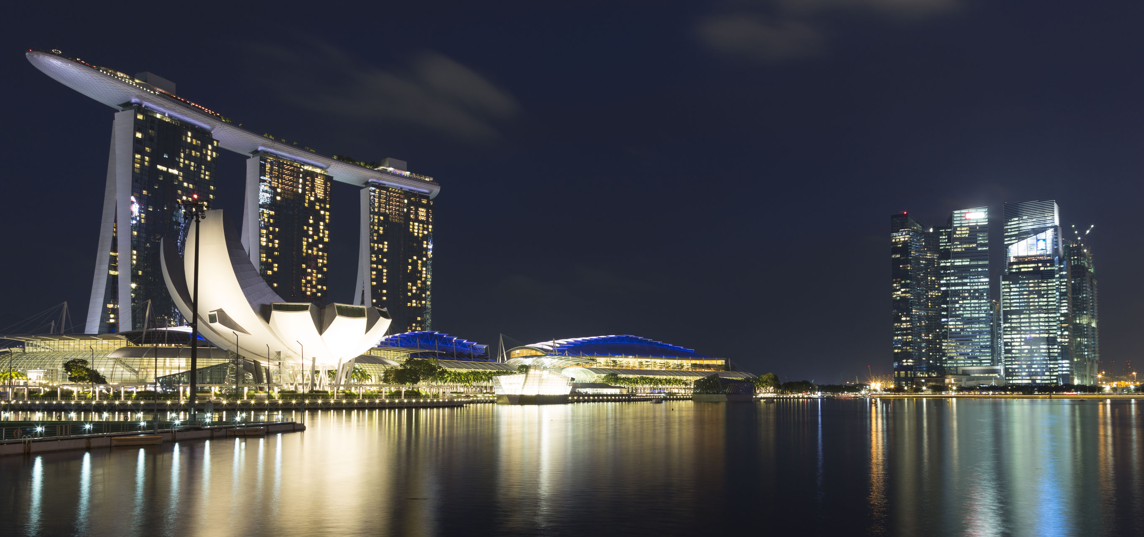





PowerShell Conference Asia
Hybrid Lab Automation
Jan-Hendrik Peters
Raimund Andrée

Slide 2
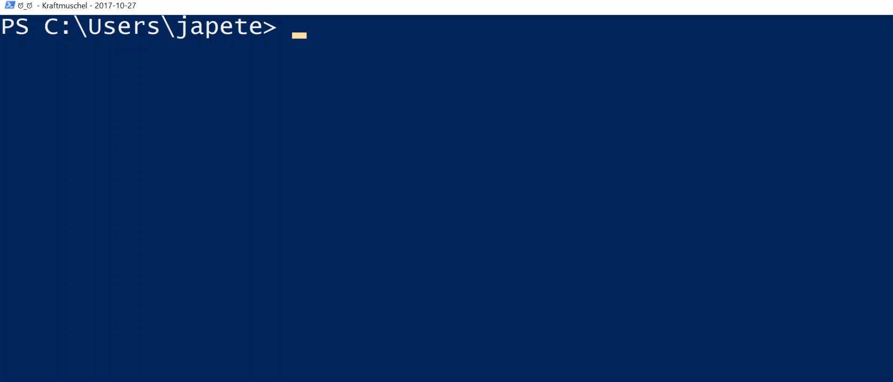

Introduction
PowerShell Conference
Singapore 2017

Slide 3
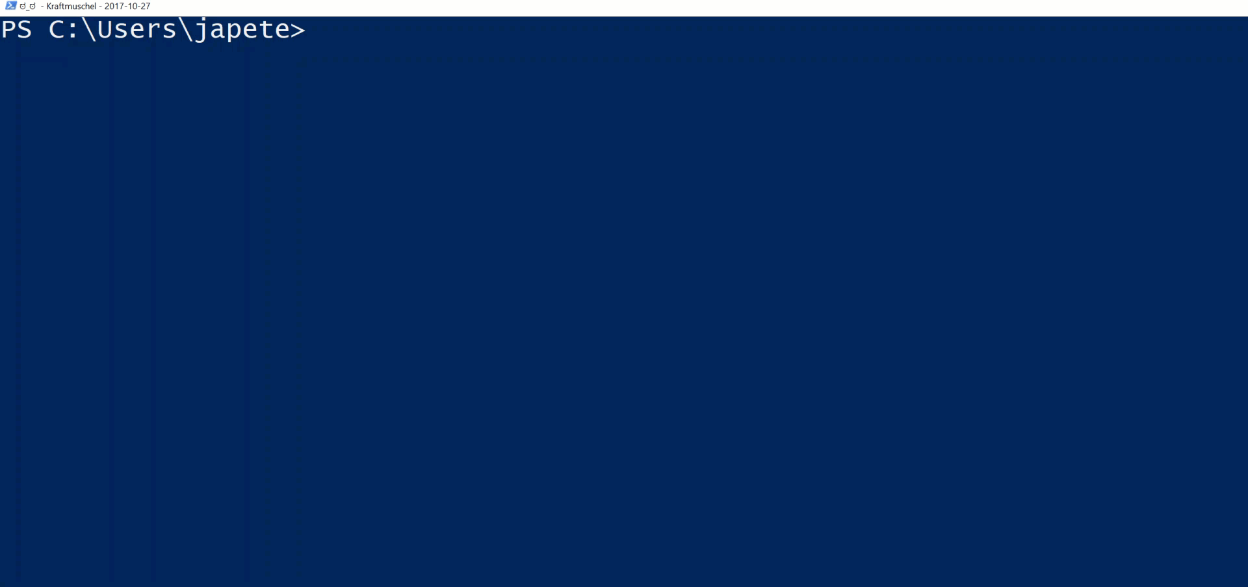
Introduction
PowerShell Conference
Singapore 2017

Slide 4
Agenda
Introduction
Why automate?
Lab environment
Creating the lab
Creating and managing the connection
PowerShell Conference
Singapore 2017

Slide 5
Why automate?
Building labs is very time consuming
Lab configuration drifts over time
Knowledge of all required products may not be sufficient, e.g. PKI, SQL and Exchange
Consistency is needed on-premises and in the cloud
PowerShell Conference
Singapore 2017

Slide 6
Why automate?
Building labs is very time consuming
Lab configuration drifts over time
Knowledge of all required products may not be sufficient, e.g. PKI, SQL and Exchange
Consistency is needed on-premises and in the cloud
BECAUSE IT IS AWESOME!
PowerShell Conference
Singapore 2017

Slide 7
Creating a lab
Module AutomatedLab (github.com/AutomatedLab)
Currently 133 cmdlets to create and manage labs
For Hyper-V, Azure and VMWare
Supports 29 different roles including
AD DS
AD CS
AD FS
SQL
…and loads more with easy customization capabilities
PowerShell Conference
Singapore 2017

Slide 8
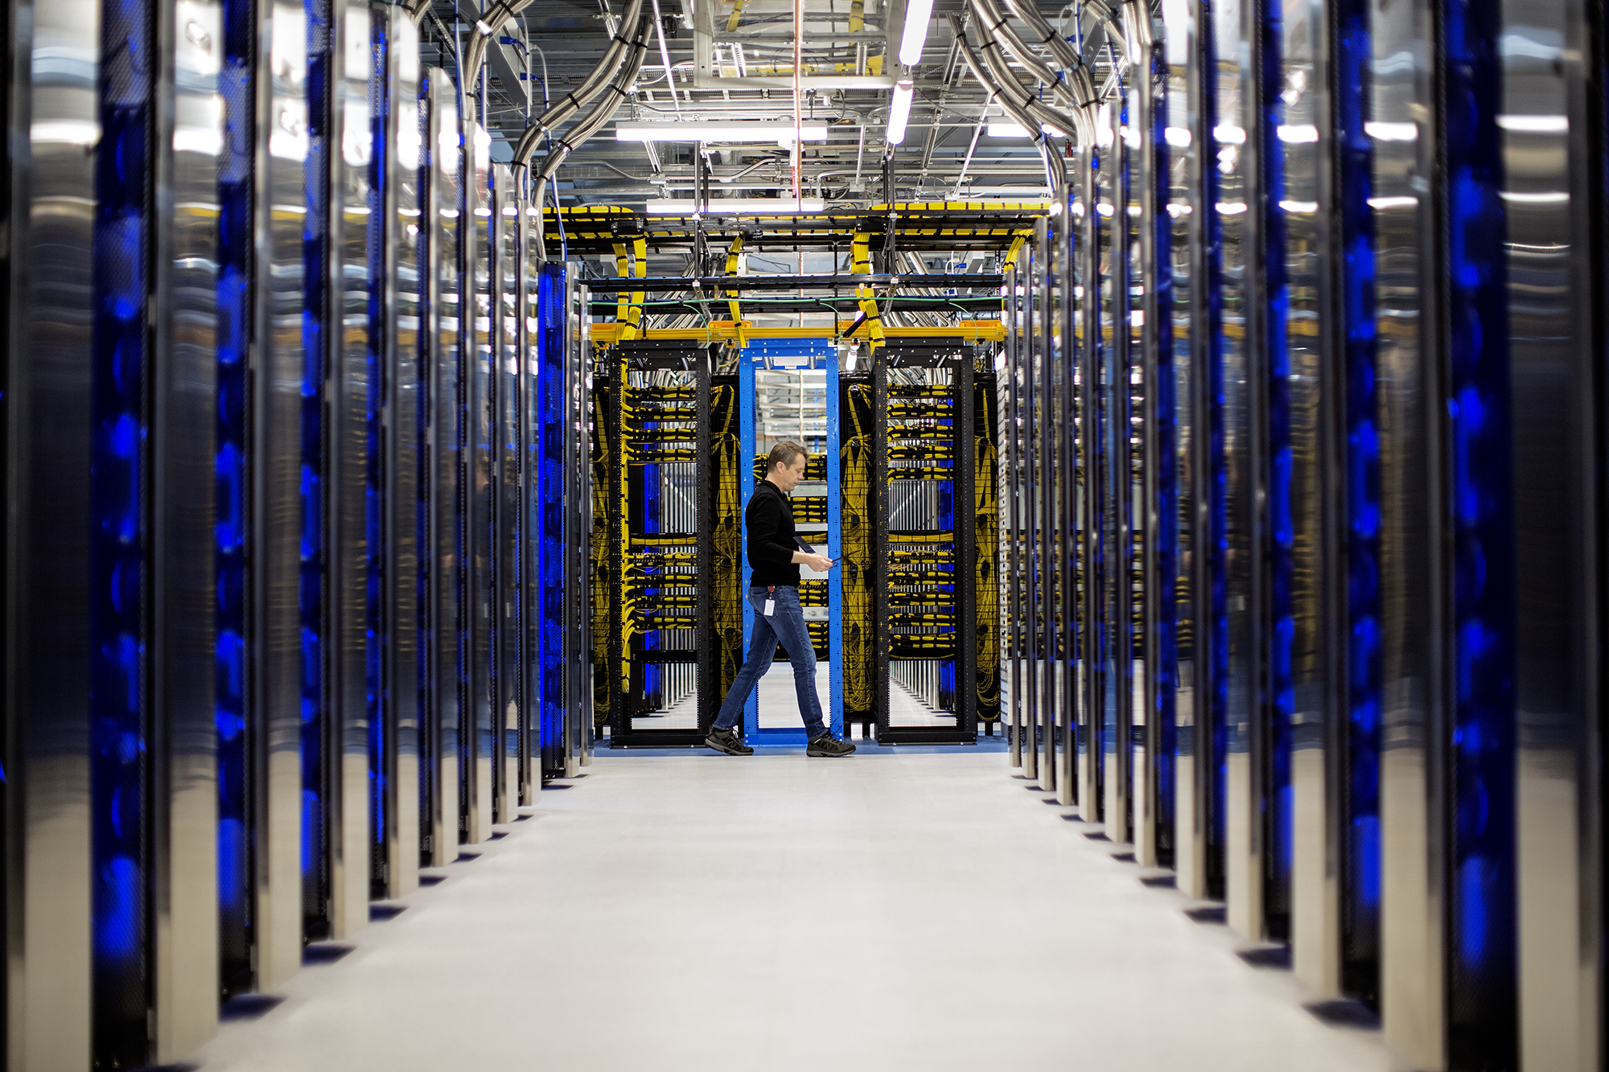
Lab Environment
PowerShell Conference
Singapore 2017

Slide 9
Hyper-V
2 Domain Controllers and ADDS deployment
6k Users
~150 organizational units
File server
Web server
Router
NIC 1 connected to lab vnet
NIC 2 routing to the internet
PowerShell Conference
Singapore 2017

Slide 10
Azure
2 Domain Controllers and ADDS deployment
6k users
~150 organizational units
File Server
Web Server
PowerShell Conference
Singapore 2017

Slide 11
Azure resource types used
Resource Group
Container for your resources. Allows RBAC
Virtual Network Gateway
Local Network Gateway
NIC
Public IP Address
Virtual Network
Virtual Network Connection
…
PowerShell Conference
Singapore 2017

Slide 12
DEMO
Creating the environments
Simple lab script to create Azure and Hyper-V environment
2 separate forests
PowerShell Conference
Singapore 2017

Slide 13
Demo
Making the connection
Connecting the two labs
PowerShell Conference
Singapore 2017

Slide 14
DEMO
Restoring the connection after infrastructural changes
PowerShell Conference
Singapore 2017

Slide 15
Demo
Removing the connection
PowerShell Conference
Singapore 2017

Slide 16
Take-aways
Easily test hybrid scenarios
Generate consistent environments every time
Help is always welcome!
Get AutomatedLab and contribute: https://aka.ms/AutomatedLab/AutomatedLab
PowerShell Conference
Singapore 2017

Slide 17
PARTYYYY
Meeting in the lobby on level 22 after this presentation
Get-Date
Party is at Penny Black
PowerShell Conference
Singapore 2017

Slide 18
Don’t Forget!
Fill in your survey in Mobile app – it’s how we do better!
Don’t lose you badge! You need it for the Social Events
Grab the Speakers for a chat – they all have time for you!
Let everyone know what they are missing on Social Media
#PowerShell
#PSConfAsia
Photos of Marina Bay Credit: Sebastian Szumigalski
PowerShell Conference
Singapore 2017

